Slide 1


Movie Recommendation System
Unsupervised_ZM6 Team
Noxolo Ngcobo
Mora Magakwe
Sandra Malope
Katleho Moketo
Matthews Montle
Supervisor:Zintle

Slide 2

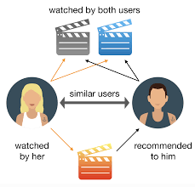
What is a movie recommendation system?
A movie recommendation system searches for content that would be interesting to an individual, it is Artificial Intelligence based algorithms that skim through all possible options and create a customized list of items that are interesting and relevant to an individual.

Slide 3
Client- Chillax
Problem Statement – Chillax has a 30% drop in their yearly revenue because they are losing clients due to clients not finding their preferred movies on the platform

Slide 4

Goal
What?
Reduced revenue means we need to create a system that retains customers
How?
To provide Chillax with the best movie recommendation system that will assist in recommending the best movies.

Slide 5


Exploratory Data Analysis

Slide 6
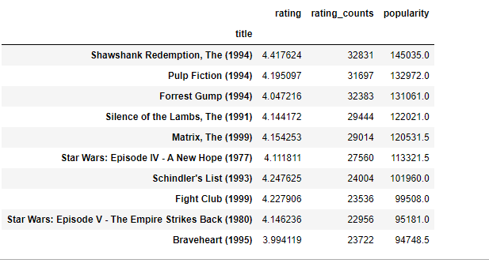

Most rated movie

Slide 7
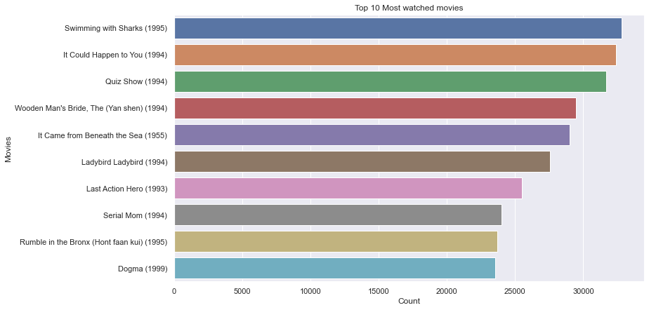

Slide 8
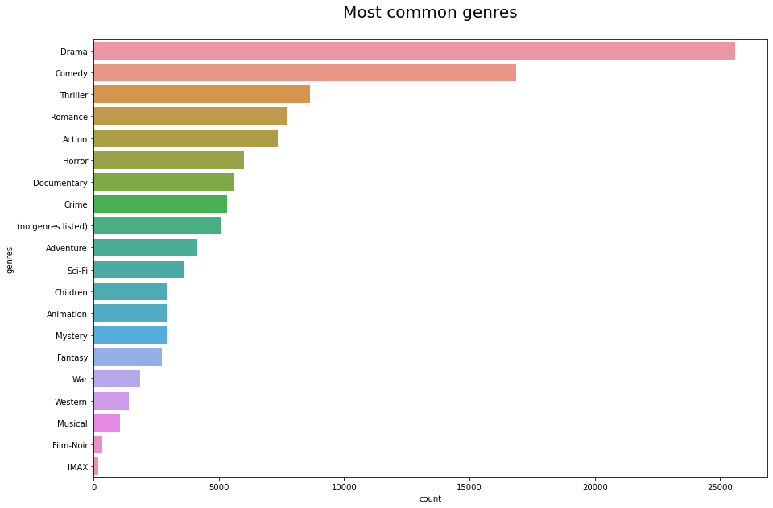
Here is the top 5 most watched common genres
Drama
Comedy
Thriller
Romance
Action

Slide 9
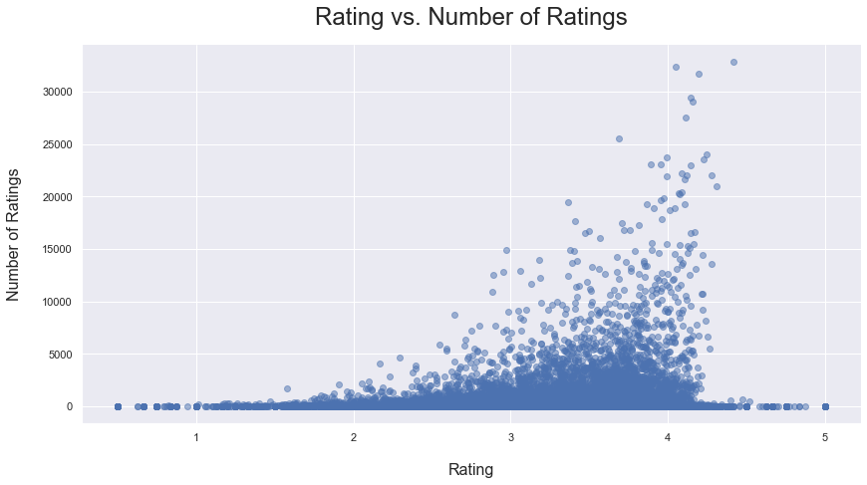
Forms an exponential curve
Positive correlation
Skewed to the left

Slide 10
actors

Slide 11
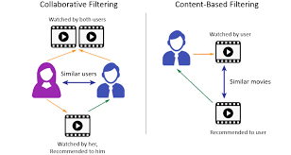
Modelling
Finding the best and most accurate model that classifies our data and gives the best movie recommendation
Content-based filtering : based on movie content
Collaborative-filtering: recommends based on similar users

Slide 12
Modelling Techniques Used
BaselineOnly: this algorithm predicts the baseline estimate for given user and item.
SVD: this algorithm is equivalent to Probabilistic Matrix Factorization ( which makes use of data provided by users with similar preferences to offer recommendations to a particular user).
SVDpp: this algorithm is an extension of SVD that takes into account implicit ratings.
NMF: this is a collaborative filtering algorithm based on Non-negative Matrix Factorization.similar to SVD.
Coclustering: is a collaborative filtering algorithm based on co-clustering.

Slide 13
Model Evaluation
Best performing model : SVD model improved using hyperparameters with an RMSE = 0,7884

Slide 14
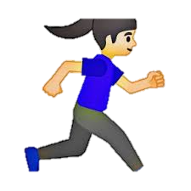


3. Recommendation System
Lets go explore the app!!!

Slide 16
The recommender system

Slide 17



Any comments.
Any questions?
Team_zm6@edsa.co.za
011 564 9655

